Slide 1


Quantitative Trading Strategies
Based on LSTM Neural Network
Xutao Chen | N13549812
Tiancheng Hou | N14508044
Mengrui Zhang | N17880728

Slide 2
Table of Contents
  Introduction to Long Short Term Memory (LSTM) Model
  LSTM Implementation
  Back Testing Result
  Conclusion & Extension

Slide 3
Introduction to
Long Short Term Memory (LSTM) Model

Slide 4
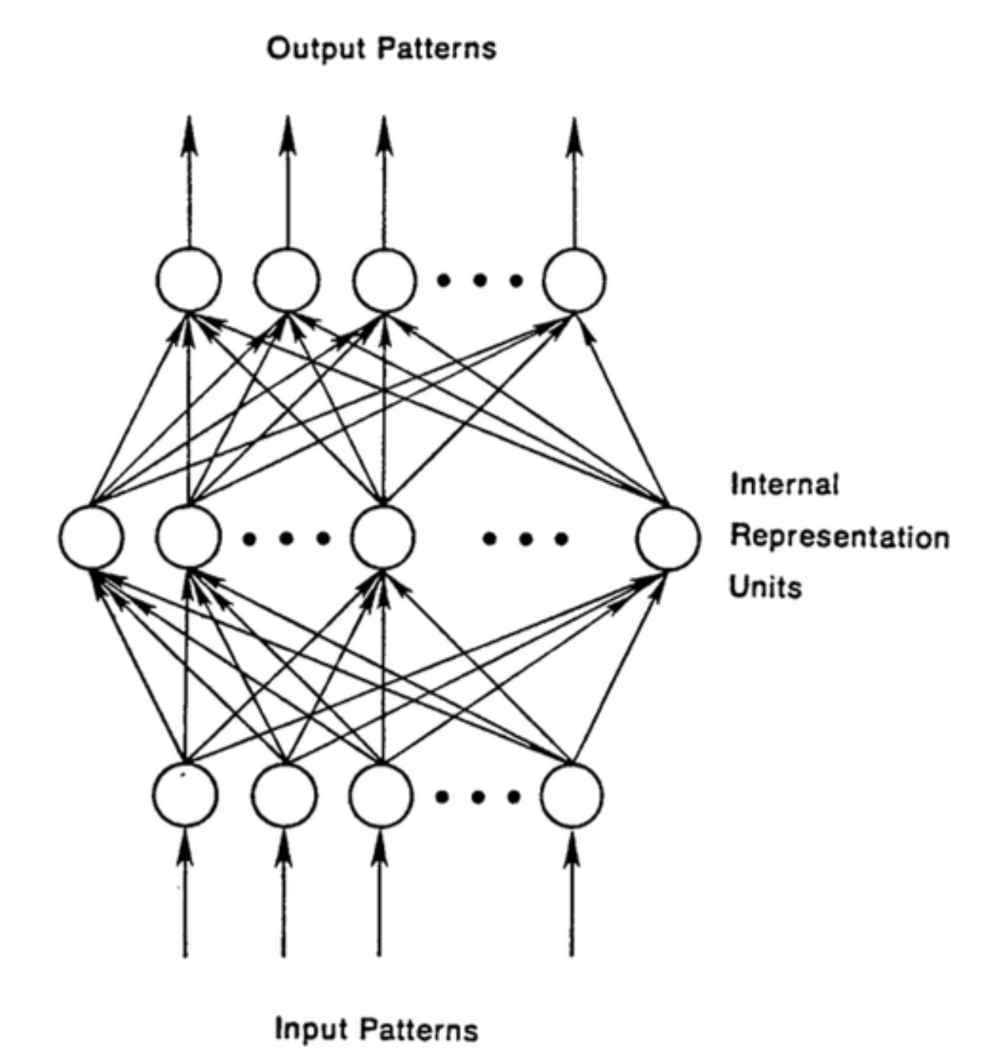
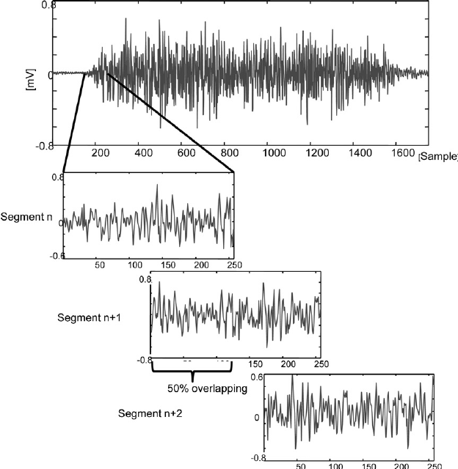
Introduction to LSTM Model
Feedforward Network vs. Recurrent Neural Network (RNN)
Time series:
Historical data are critical
One-to-One mapping:
Input => Output
Traditional Method:
Sliding Window

Slide 5
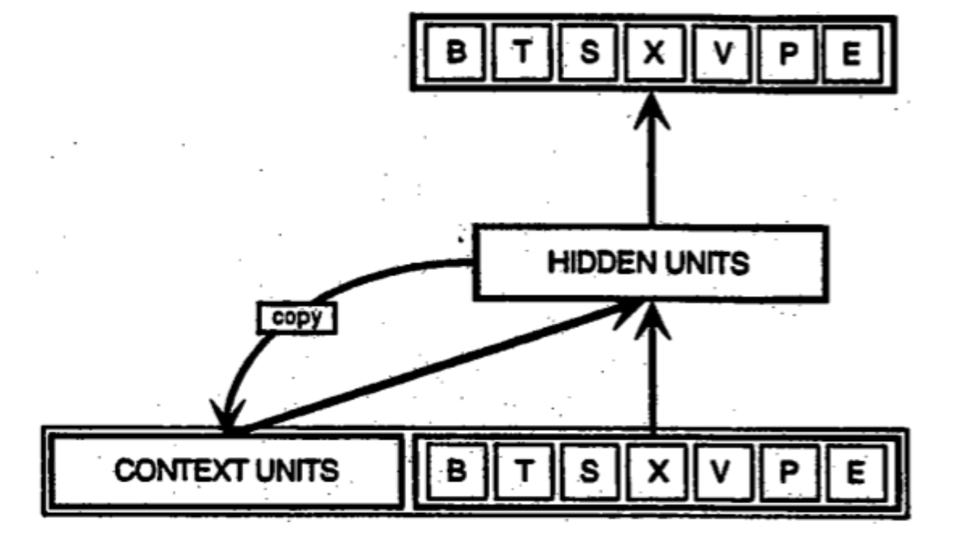
Introduction to LSTM Model
Feedforward Network vs. Recurrent Neural Network (RNN)
Solution:
Recurrent Neural Network
Sliding Window Drawback:
No explicit notion of timeframe
Remember context through recurrent connection
Recognize time: Explicit order of the sample
Can carry long term memory

Slide 6
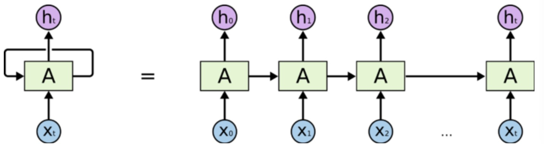
Introduction to LSTM Model
Unfolding Recurrent Neural Network
Features of each time step are passed into the block in sequence
The current state of the block is affected by previous states

Slide 7
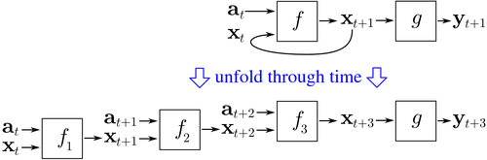
Introduction to LSTM Model
Training Method: Backpropagation through time (BPTT)
Algorithm:
Unfold RNN to a multi-layer feedforward network
Do backpropagation
Apply the sum of all gradients resulting from the same parameter
f1, f2, f3 have the same weight parameters as f

Slide 8
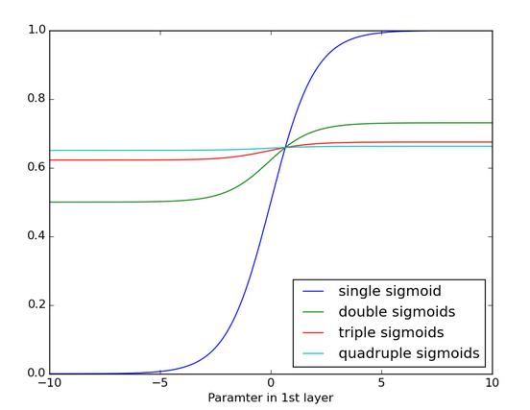
Introduction to LSTM Model
BPTT Difficulty: Vanishing Gradient
Unfolding RNN
=> Too many layers
=> Memory go through sigmoid function many times
=> Vanishing Gradient
=> Unable to update f1 weights effectively
Function flatten: Gradient approach zero

Slide 9
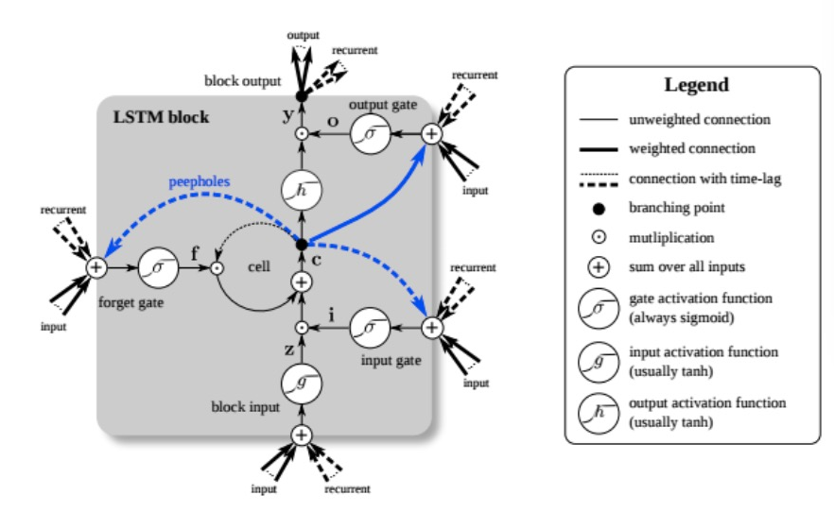
Introduction to LSTM Model
Long-Short-Term Memory (LSTM) Model
Key Structure of a LSTM Block
Input gate
Forget gate
Output gate
Avoid vanishing gradient:
Internalize recurrent connection
Use plus instead of sigmoid

Slide 10
LSTM Implementation

Slide 11
LSTM Implementation
Data Selection
Data Source: Yahoo Finance
Date range: 2008/01/02 – 2017/12/29
Daily high, low, close price data
Total 54 stocks
From 9 main industries according to Yahoo Finance
For each industry, choose 6 stocks with different market capitalization
Stock list:
AAPL,ABB,ADBE,AEP,AMGN,AMZN,BA,BBD,BP,BTI,C,CAT,CBCELG,CODI,COST,CRH
CVS,D,E,EIX,EOG,ETN,FDX,GOOGL,GSK, HMC,HON,HRG,IEP,INTC,JNJ,JPM,MDLZ,MS
MSFT,NEE,NFLX,NVDA,NVS,OKE,OXY,PICO,REX,RIO,SAP,SCHW,SU,TM,TSM,UN, WBA,WEC,WMT

Slide 12
LSTM Implementation
Input of LSTM Model
64 Features Total
Daily returns of 54 stocks
Ten Technical Indicators:
Median return
20 days Moving Standard Deviation
Stochastic Oscillator D
MACD: Macd, sign and diff
RSI
CCI
ADX
TRIX

Slide 13
LSTM Implementation
Target of LSTM Model
We frame the trading strategy as a binary classification problem
Stocks are classified into two types, winner (class 1) and loser (class 0)
The label is given by stocks’ performance next month
We classify a stock as winner/loser if its return is above/below the median return
LSTMs are used as a hidden layer
The classification is done by combining LSTM output through a sigmoid neuron

Slide 14
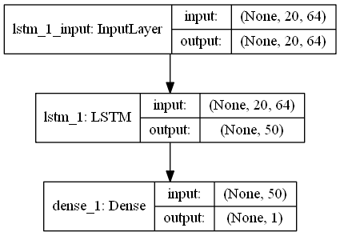
LSTM Implementation
Structure of our Neural Network
20 lookback period * 64 features at each period
(10 technical indicators + 54 stocks’ daily return)
50 LSTM Block
1 Sigmoid Output Neuron
Each stock has its own LSTM network
The classification of each stock is independent
Implemented on Tensorflow + Keras

Slide 15
LSTM Implementation
Program Workflow
Convert to supervised data frame
Train LSTM
Find the best parameters by validation
Get block of data
Predict next month’s performance
Record prediction
Load Data
Preprocessing Data
Rolling Prediction
  Calculate 10 indicators
  Get target variable: classify stocks into winning/losing group
  Prediction next month’s winner/loser
  Add next month’s data to training set
  Retrain

Slide 16
LSTM Implementation
Parameters
holding = 20 # Holding period and retrain frequency
rf = 0.02/12 # Risk-free rate
n_block_len = 200 # Length of historical data used in training
training_ratio = 0.8 # Ratio of samples used in training, others used as validation set
lookback_window = 20 # Days of info in one training sample
first_train_max_epoch = 150 # Maximum training epoch after network initialization
online_train_max_epoch = 150 # Maximum training epoch once new data comes in
n_LSTM_node = 50 # number of LSTM blocks used in network
block_start_idx = 300 # Start point to train, i.e. 2009/05/08

Slide 17

LSTM Implementation
Optimization: Cloud Computing & GPU Acceleration
Motivation:
Each stock needs to run a neural network with 50 LSTM blocks
Time consuming, complete rolling prediction needs >5 hours
Solution:
We use Amazon AWS EC2 cloud platform to run our training process
Our computation server has 36 vCPUs and 72GB memory
On local machine, we use CUDA technology to accelerate training by utilizing GPU

Slide 18
Back Testing Result

Slide 19
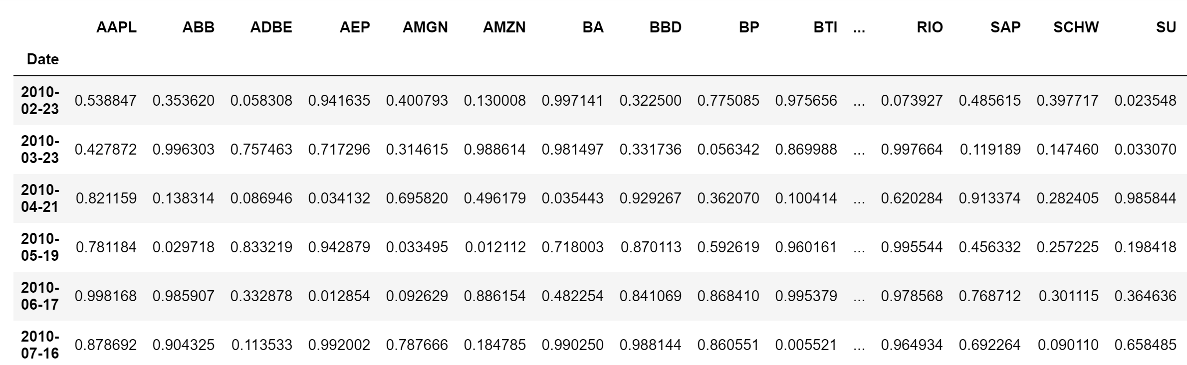
Back Testing Result
Sample Classification Result
Predicted classification of 96 months
From 2010/02/23 to 2017/09/08
Our back testing will be conducted on these results

Slide 20
Back Testing Result
Trading Strategy
Rank each stock by its winning probability
Strategy 1:
Long the first N stocks
Strategy 2:
Long the first N and last N stocks
Weight :
Proportional to excess probability w.r.t. the minimum among selected stocks

Slide 21
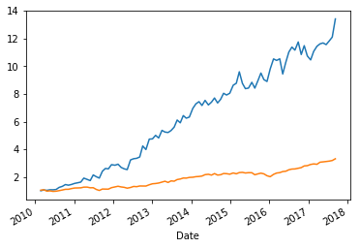
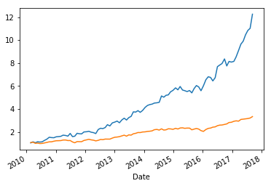
Back Testing Result
Long the top N stock in the winning group
 | LSTM (Long 1) | LSTM (Long 2) | Benchmark
Sharpe | 1.3518 | 1.6136 | 1.10
Maximum Drawdown | -13.21% | -14.82% | -18.67%
Annualized Return | 38.33% | 36.79% | 16.23%
Cumulative Return | 1241% | 1126% | 233%

Slide 22
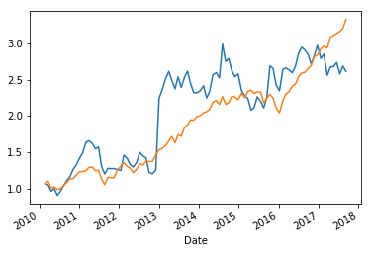
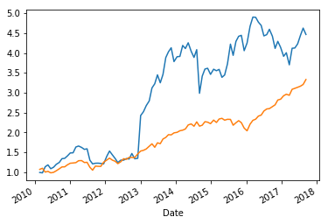
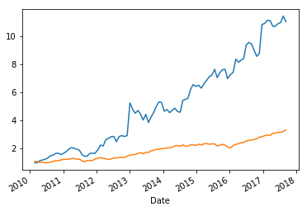
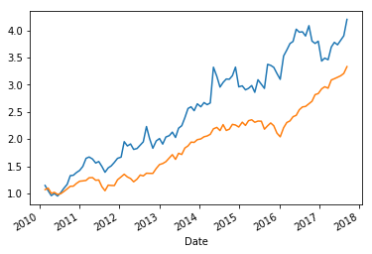
Back Testing Result
Underfitting and Overfitting
Epoch | 50 | 70 | 100 | 150
Sharpe | 0.4221 | 0.6118 | 0.9116 | 0.8500
MDD | -30.50% | -29.85% | -29.63% | -17.89%
CR | 161% | 347% | 1004% | 302%

Slide 23
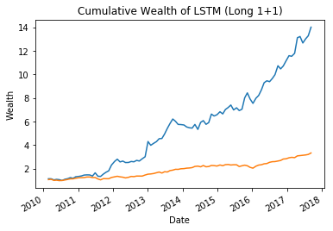
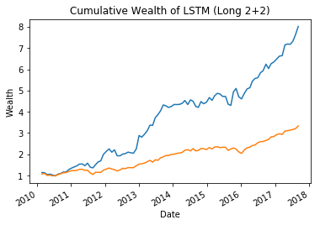
Back Testing Result
Long the top N stock in the winning/losing group
 | LSTM (Long 1+1) | LSTM (Long 2+2) | Benchmark
Sharpe | 1.3010 | 1.2891 | 1.10
Maximum Drawdown | -18.51% | -14.38% | -18.67%
Annualized Return | 39.11% | 29.70% | 16.23%
Cumulative Return | 1302% | 701% | 233%

Slide 24
Conclusion & Extension
Conclusion
LSTM performs well in classification on time series data
Portfolios constructed based on LSTM prediction outperform benchmark portfolio
Extension
With more computation resource (i.e. Cloud), we can extend the stocks pool from 54 to 500 or even more
As stocks pool become large, we can include more stocks while constructing portfolio, leading to diversification advantage – higher Sharpe Ratio and lower risk

